Slide 1
CSE440: Natural Language Processing II
Dr. Farig Sadeque
Associate Professor
Department of Computer Science and Engineering
BRAC University

Slide 2
Lecture 2: Linguistics Essentials

Slide 3
Topics
Common NLP components
Sentence segmentation
Tokenization
Lemmatization/Stemming
Parts-of-Speech tagging
Named Entity Recognition
Parsing
Coreference Resolution
Hands-on Demonstration
Next class
Install SpaCy and NLTK on your computer!

Slide 4
NLP Annotations
Associating extra information to a piece of text
Example:
Dr. Jennifer Smith visited China. She liked it very much.

Slide 5
NLP Annotations
Associating extra information to a piece of text
Example:
Dr. Jennifer Smith visited China. She liked it very much.
Dr./propn Jennifer/propn Smith/propn visited/verb China/propn ./punc
She/pron liked/verb it/pron very/adv much/adv ./punc
This is called Parts-of-Speech tagging.

Slide 6
More Annotations: Dependencies, Named Entities, Coreference
Dr./propn Jennifer/propn Smith/propn visited/verb China/propn ./punc
compound
punct
nsubj
dobj
compound
GPE
person
She/pron liked/verb it/pron very/adv much/adv ./punc

Slide 7
Common NLP Components
Sentence segmentation
Tokenization
Lemmatization/Stemming
Parts-of-Speech tagging
Named Entity Recognition
Parsing
Coreference Resolution

Slide 8
Sentence Segmentation: Challenges
How do you know where an English sentence ends?

Slide 9
Sentence Segmentation: Challenges
How do you know where an English sentence ends?
Consider: Mr. Smith lives in the U.S.A. He said “I am an American citizen!”

Slide 10
Sentence Segmentation: Challenges
How do you know where an English sentence ends?
Consider: Mr. Smith lives in the U.S.A. He said “I am an American citizen!”
Many ‘.’ ‘!’ and ‘?’ end sentences but not all:
Some ‘.’ are in abbreviations
Some ‘.’ in abbreviations also end sentences
Quotes after ‘.’ ‘!’ or ‘?’ are in the same sentence
etc.

Slide 11
Sentence Segmentation: Solution
Rules:
Easy to write a few rules
Large rule sets are hard to maintain

Slide 12
Sentence Segmentation: Solution
Rules:
Easy to write a few rules
Large rule sets are hard to maintain
Machine learning:
Classify each punctuation character: sentence final?
Features: surrounding characters, words
Around 99% accuracy

Slide 13
Sentence Segmentation: Solution
Rules:
Easy to write a few rules
Large rule sets are hard to maintain
Machine learning:
Classify each punctuation character: sentence final?
Features: surrounding characters, words
Around 99% accuracy
Parsing (spacy’s algorithm):
Let the dependency parser figure it out

Slide 14
Tokenization: Brainstorming
Someone has told you that words in English can be separated by simply splitting on whitespace. How many times would that heuristic fail for the following text?
Mr. O’Neill said reaction to Sea Container’s proposal “hasn’t been very positive.” In New York Stock Exchange composite trading yesterday, Sea Containers closed at $62.625, down 62.5 cents.
What could you do to improve the heuristic?

Slide 15
Tokenization Challenges
Words with punctuation: C++, C#, M*A*S*H, etc.
Emoticons: =) :) ;-) etc.
Contractions: I’ll, isn’t, dog’s, etc.
Typically split to separate, e.g., noun (I) from verb (’ll)
Hyphens in words: e-mail, co-operate, etc.
Hyphens between morphemes: non-lawyer, pro-Arab
Hyphens between words: once-quiet study,
take-it-or-leave-it offer, 26-year-old, etc.
Names: New York vs. York
Phrasal verbs: make up, work out, etc.
Phone numbers: +(880) 1756-111111

Slide 16
Tokenization Challenges
How about other languages?
Chinese: 我正在教一堂課
Means “I am teaching a class.”
each character is a word, simpler characters build complex ones, and there is no space!
German: Lebensversicherungsgesellschaftsangestellter (pronounce this!)
Means “life insurance company employee”

Slide 17
Tokenization Challenges
How about other languages?
Chinese: 我正在教一堂課
Means “I am teaching a class.”
each character is a word, simpler characters build complex ones, and there is no space!
German: Lebensversicherungsgesellschaftsangestellter (pronounce this!)
Means “life insurance company employee”
How about Bangla?
Let me present you the one and only Michael Madhusudan Dutta
নিকুম্ভিলা যজ্ঞ সাংগ করি, আরম্ভিলে/যুদ্ধ দম্ভি মেঘনাদ, বিষম সঙ্কটে/ঠেকিবে বৈদেহীনাথ, কহিনু তোমারে

Slide 18
Tokenization Solutions
Unfortunately, no general solution. Each language requires it’s own tokenization principles.
How does common tools do it then?
Spacy: recursively split on whitespace, known exceptions, affixes, and punctuation

Slide 19
Problem: Similar Words Look Different
The words dog and dogs are closely related, but on a computer "dog" != "dogs"
Solutions:
Cut out common substrings (stemming/lemmatization)
Replace words with vectors (embeddings)

Slide 20
Stemming and Lemmatization
Stemming:
Rules strip pieces of words (not morphemes)
E.g, Porter stemmer: equivalence → equival
Fast, but inaccurate, e.g., organization → organ, European !→ Europe

Slide 21
Stemming and Lemmatization
Stemming:
Rules strip pieces of words (not morphemes)
E.g, Porter stemmer: equivalence → equival
Fast, but inaccurate, e.g., organization → organ, European !→ Europe
Lemmatization
Hand-built lexicon for all word forms, walked → walk
Accurate, but slower, and there is a chicken-egg scenario with parts of speech tagging

Slide 22
Embedding
If dog = [0.5; 0.4; 0.1] and dogs = [0.5; 0.4; 0.2]
then cos dog; dogs = 0:99
Goal: learn an embedding vector for each word such that similar words have similar vectors.
Will be covered in session 3.

Slide 23
Before moving on
Our next overview is going to be on Parts of Speech tagging. Before starting that, please review these two links:
Penn TreeBank tags:
https://www.ling.upenn.edu/courses/Fall_2003/ling001/penn_treebank_pos.html
Section 2 and 3
Universal POS tags:
https://universaldependencies.org/u/pos/all.html

Slide 24
NLP Libraries
 | SpaCy | NLTK | CoreNLP | Processors
Fast | yes | no | yes | yes
State-of-the-art | yes | no | yes | yes
Large community | yes | yes | yes | no
Simple APIs | yes | yes | no | no
Language | Python | Python | Java | Scala
Before next class, please install SpaCy and NLTK on your computer

Slide 25
Parts-of-Speech (POS) Tagging
Assigning grammatical categories for words
She/pron liked/verb it/pron very/adv much/adv ./punc
closed class
categories have a fixed set of words
prepositions, determiners, pronouns, conjunctions, auxiliary verbs, particles, numerals
open class
categories have a growing set of words
nouns, verbs, adjectives, adverbs

Slide 26
POS tagging
noun “person, place, or thing”: farmer, Dhaka, dice but also explosion, moment
verb “action or process”: grab, evolve, rain
adjective “property or quality”, modify nouns: green, old
adverb “modify verbs and adjectives”: slowly, very, today
adposition “before/after a noun phrase”: over, before
determiner “express reference of noun”: a, the, that
pronoun “substitute for noun”: you, our, who
conjunction “join two phrases”: and, but, if
particle “associated with other word”: not, maybe rule out
interjection “exclamation”: psst, ouch, hello

Slide 27
POS Tagging Challenges
One word can have different POS tag based on its use
I painted the room vs. the painted room
Is painted a verb or an adjective?
Annotate the following sentence with POS tags from Penn TreeBank tags:
“Wow! That first post really blew up.”

Slide 28
Named Entity Recognition (NER)
Identify phrases that are named people, locations, organizations, etc.
Dr./propn Jennifer/propn Smith/propn visited/verb China/propn ./punc
Common named entity types:
person Turing is often considered the. . .
organization The IPCC said it is likely that. . .
location The Mt. Sanitas loop hike. . .
geo-political entity Palo Alto will raise parking fees.
etc.
punct
Person
GPE

Slide 29
NER Challenges
Ambiguity:
Washington was born into slavery.
Washington went up 2 games to 1.
Blair arrived in Washington today.
Washington passed a primary seatbelt law.

Slide 30
NER Challenges
Ambiguity:
Washington was born into slavery. <per>
Washington went up 2 games to 1. <org>
Blair arrived in Washington today. <loc>
Washington passed a primary seatbelt law. <gpe>

Slide 31
Solution
Sequence Tagging
Will study it in session 4
Simple scheme: label each word as (I)nside or (O)utside
More elaborate schemes:
BIO: begin, inside, outside
BILOU: begin, inside, last, outside, unit-length

Slide 32
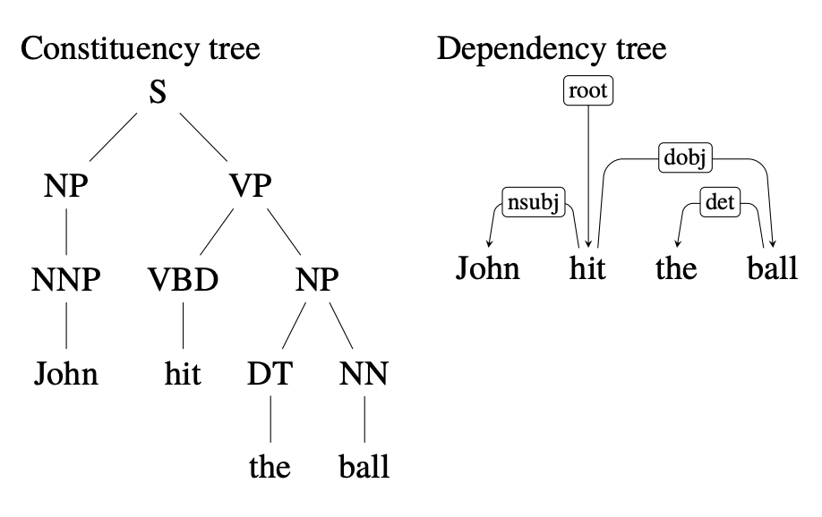
Parsing and Syntactic Representation
Example: John hit the ball.

Slide 33
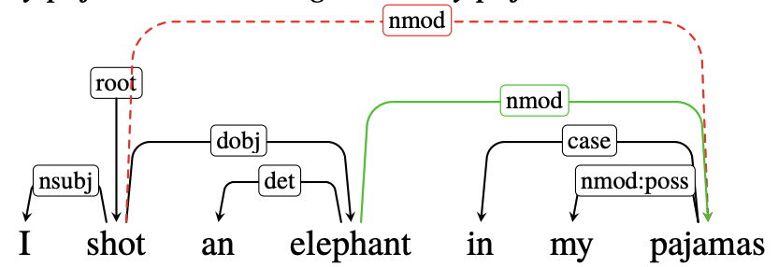
Parsing Challenges
Attachment ambiguity: One morning I shot an elephant in my pajamas.
Who was in my pajamas? Me? The elephant?

Slide 34
Coordination Ambiguity
Old men and women
Old (men and women)?
Old (men) and women?
Which one is correct?

Slide 35
Parsing solutions
Probabilistic grammar based parsing
Transition based parsing
We will learn theories of parsing in session 5

Slide 36
Demo
We will now check out some of the tools that are available to us.
SpaCy
NLTK
Stanford CoreNLP

